Slide 1
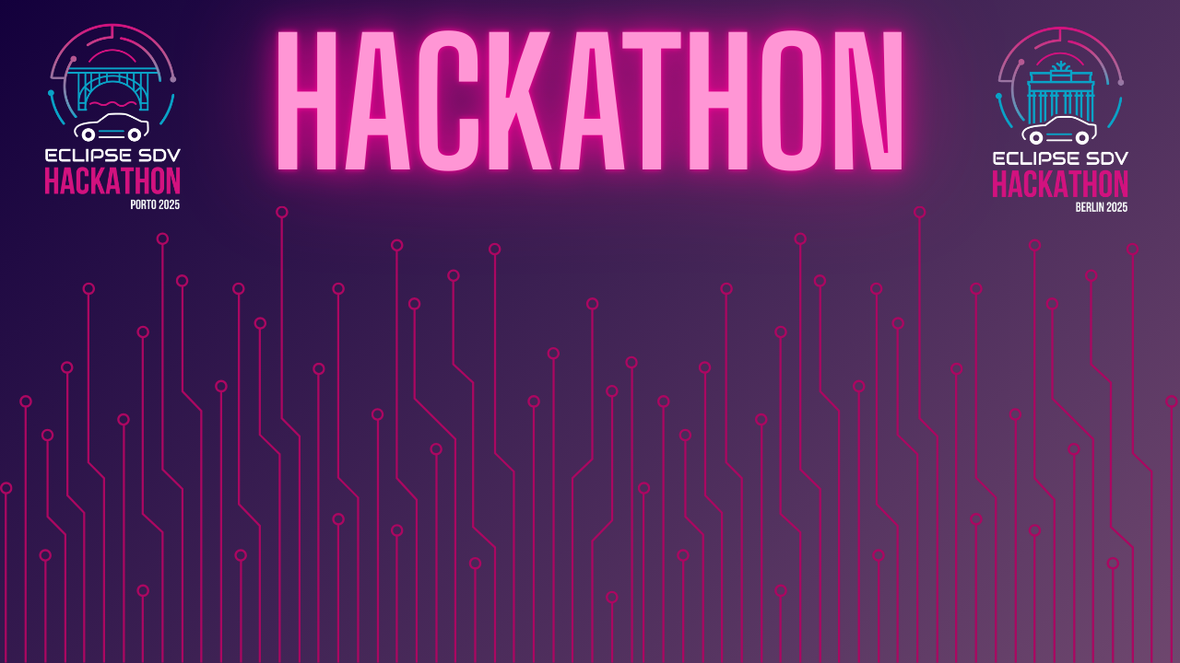

Chapter III - 2025
COPYRIGHT (C) 2025, ECLIPSE FOUNDATION

Slide 2
SDVenturers
Mood Detection and Action
COPYRIGHT (C) 2025, ECLIPSE FOUNDATION

Slide 3
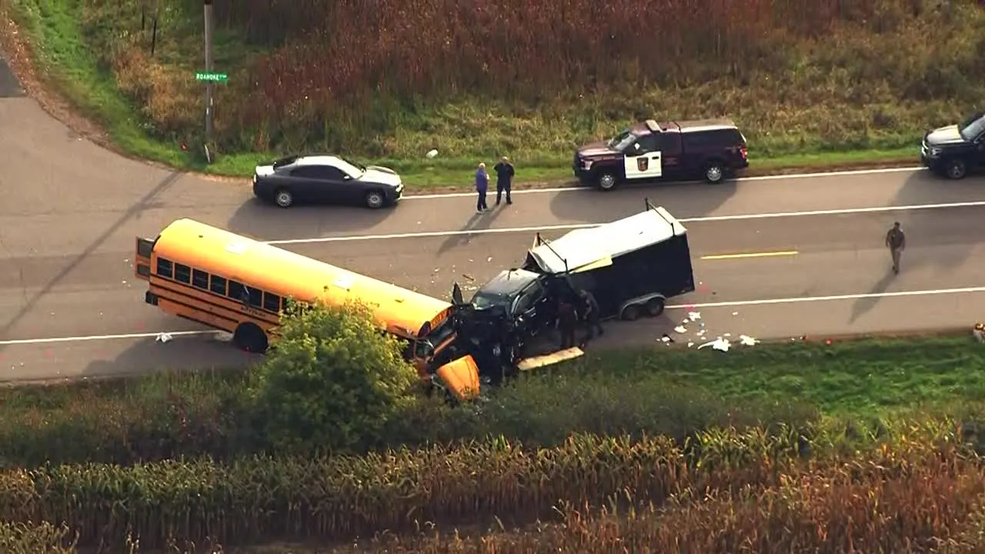


Slide 4

Mood Detection and Action

Slide 5
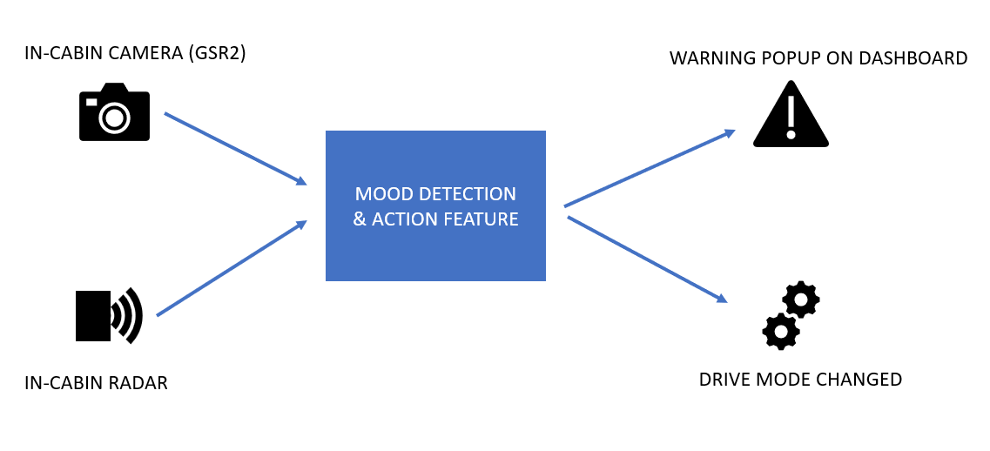

Slide 6

The Added Value

Slide 7

The Market & The Competition

Slide 8
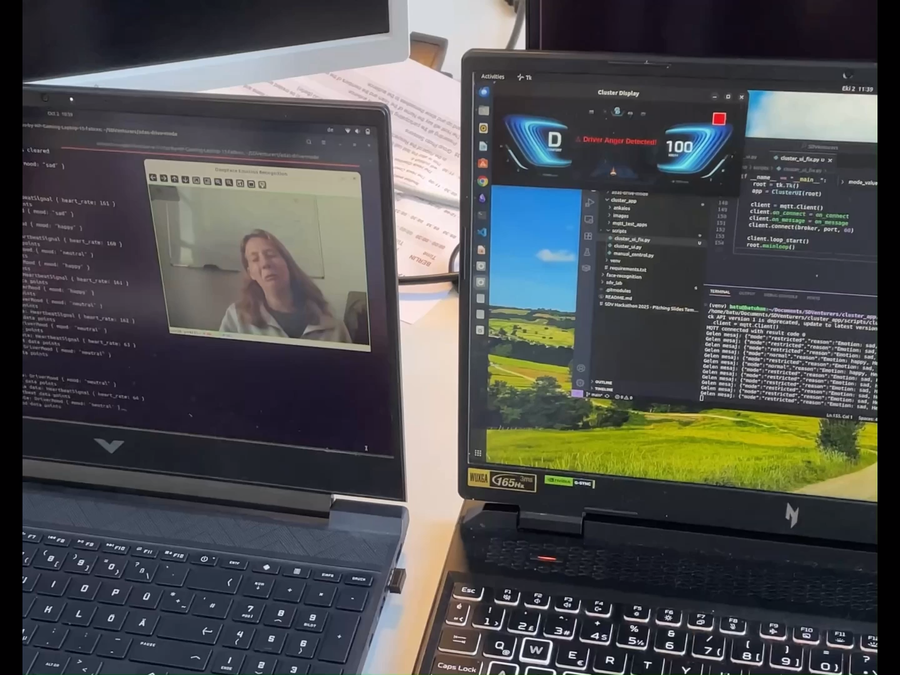
Demo

Slide 9

Team and Structure
Pascal Kneuper : System Build, System Integration, Software Development
Adarsh Rastogi : System Build, System Integration, Software Development
Aniket Barve : System Build, System Integration, Software Development
Tessa Talsma : System Build, System Integration, Software Development
Batuhan Arslan : System Build, System Integration, Software Development

Slide 10
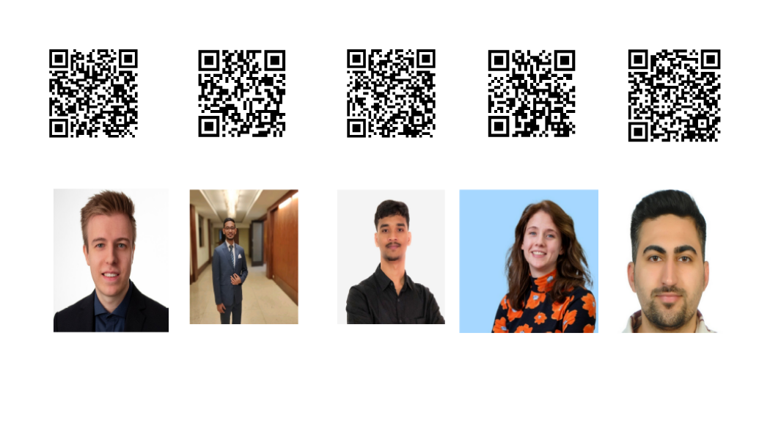
Contact

Slide 11
Thank your audience and encourage them to get in touch afterwards.
COPYRIGHT (C) 2025, ECLIPSE FOUNDATION

